Slide 1

Classification
Supervised Machine Learning 2nd Type

Slide 2

Classification
Machine Learning Classification is a process of categorizing a given set of data into classes, It can be performed on both structured or unstructured data

Slide 3
Categorical Data
Categorical data is when numbers are collected in groups or categories. Categorical data is also data that is collected in an either/or or yes/no situation.
Analysis of the customer data to predict whether he will buy computer accessories (Target class: Yes or No)
Classifying fruits from features like color, taste, size, weight (Target classes: Apple, Orange, Cherry, Banana)
Gender classification from hair length (Target classes: Male or Female)

Slide 4
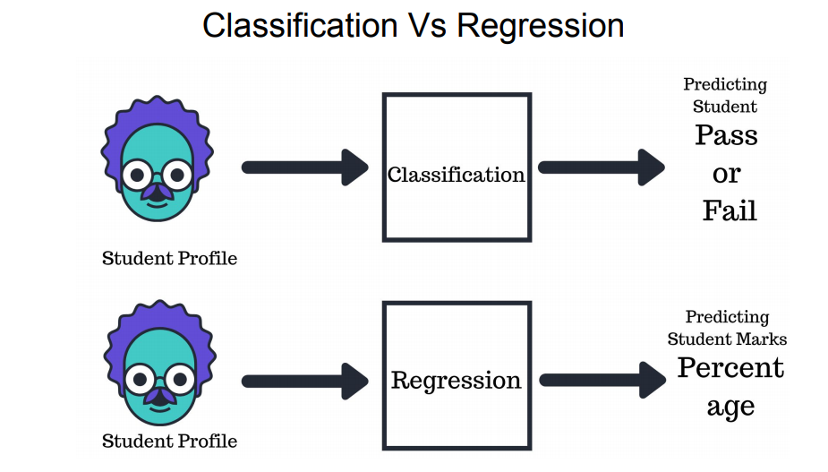

Slide 5
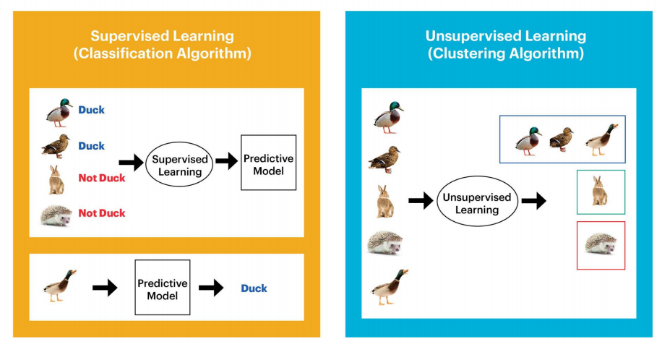

Slide 6
Types Of Classification
In Classification we have different types
Binary Classification
Multi-Class Classification
Multi-Label Classification
Imbalanced Classification

Slide 7
Binary Classification
Binary Classification: Classification task with two possible outcomes. Eg: 1. Gender classification (Male/Female)
2. Email spam detection (spam or not)
binary classification tasks involve one class that is the normal state and another class that is the abnormal state.
Popular algorithms that can be used for binary classification include:
Logistic Regression ( It Supports only for Binary )
k-Nearest Neighbors
Decision Trees
Support Vector Machine ( It Supports only for Binary )
Naive Bayes

Slide 8


Slide 9
Multi-Class Classification
Multi-class classification refers to those classification tasks that have more than two class labels
Eg:1. Face classification.
2. Plant species classification.
Popular algorithms that can be used for multi-class classification:
k-Nearest Neighbors.
Decision Trees.
Naive Bayes.
Random Forest.
Gradient Boosting.

Slide 10
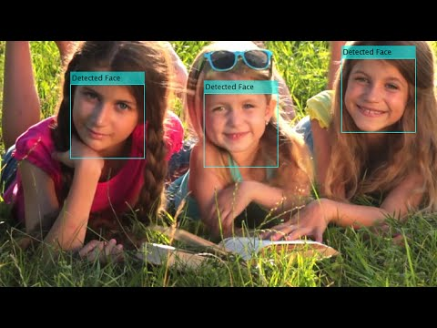
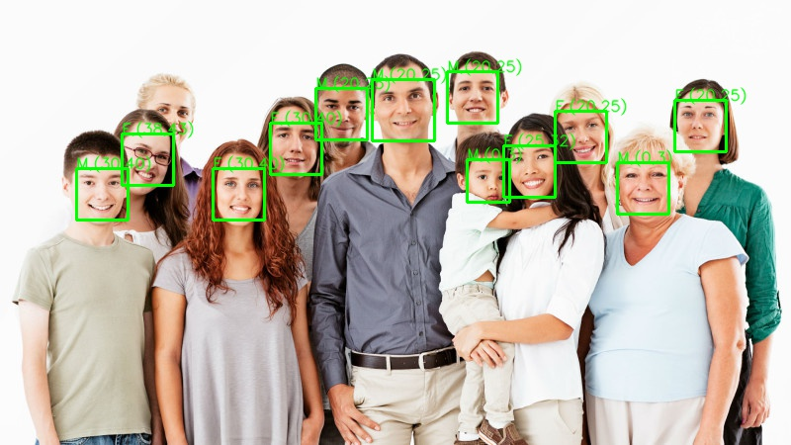
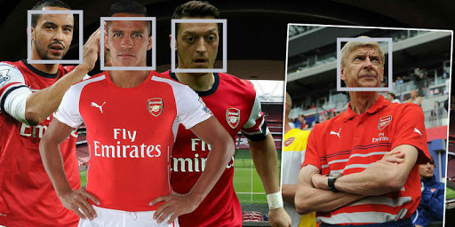

Slide 11


Slide 12
Multi Label Classification
Multi-label classification involves predicting zero or more class labels. Unlike normal classification tasks where class labels are mutually exclusive, multi-label classification requires specialized machine learning algorithms that support predicting multiple mutually non-exclusive classes or “labels.”

Slide 13
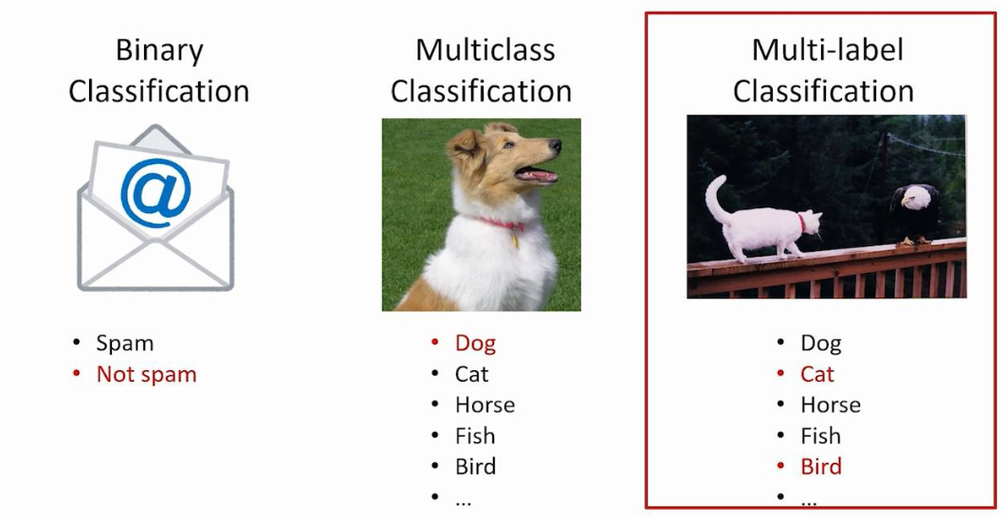

Slide 14
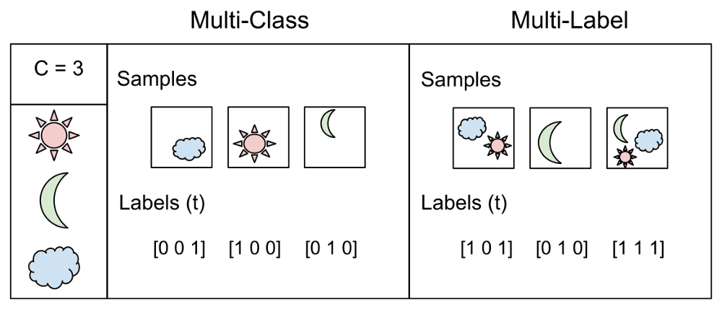

Slide 15

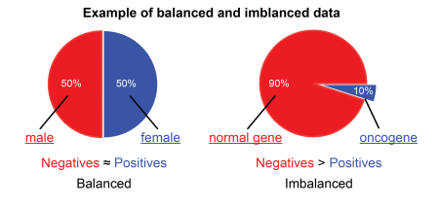
Imbalanced Classification
Imbalanced classification refers to a classification predictive modeling problem where the number of examples in the training dataset for each class label is not balanced. That is, where the class distribution is not equal or close to equal, and is instead biased or skewed

Slide 16
KNN Algorithm
Classification Algorithms
K-Nearest Neighbour(KNN)
Logistic Regression
Decision Tree
Support Vector Machine
Random Forest

Slide 17
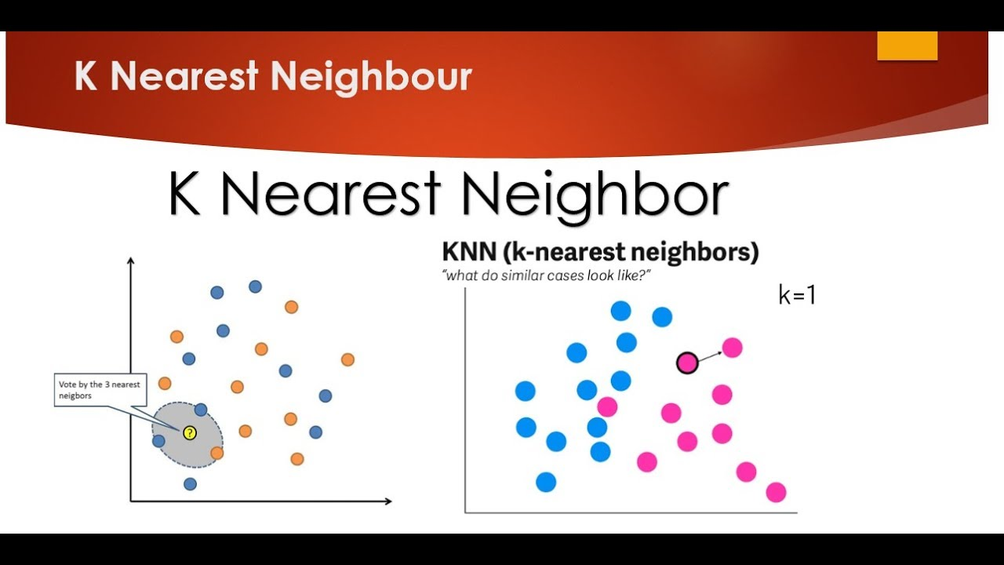

Slide 18
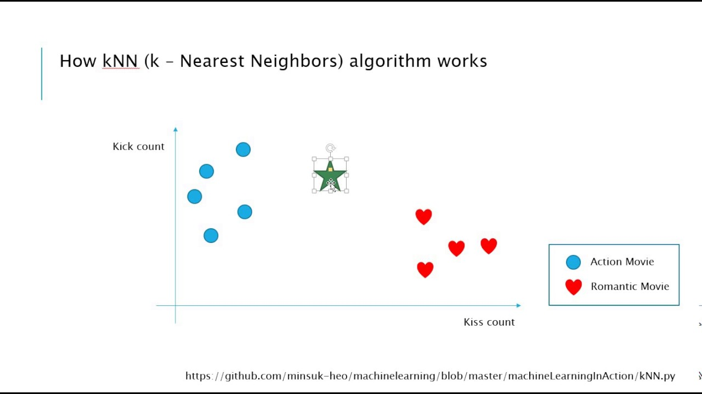

Slide 19
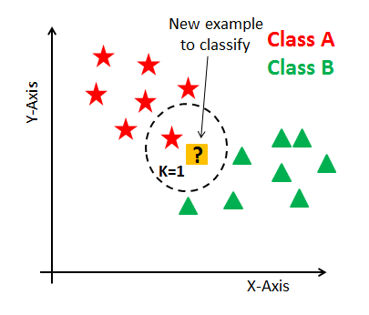
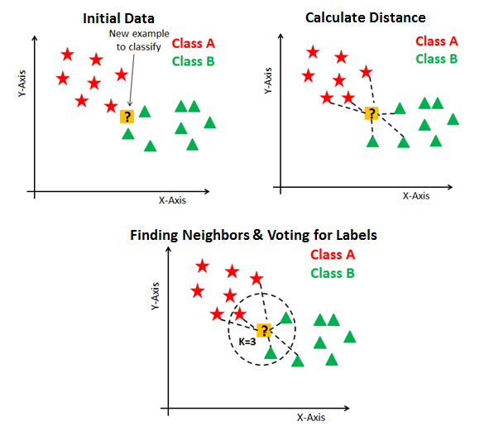

Slide 20
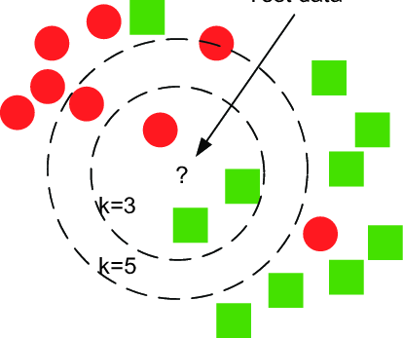
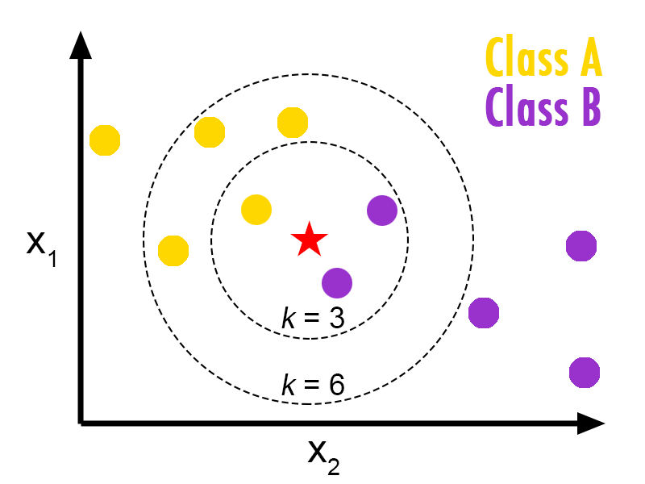

Slide 21
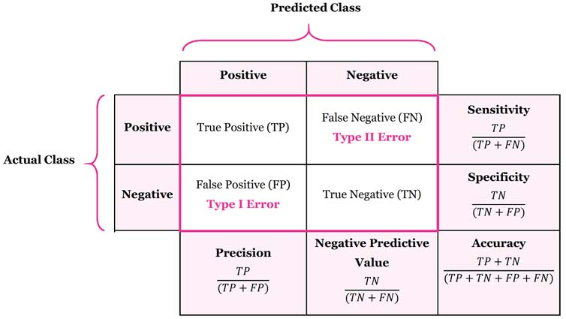

Slide 22
Accuracy = (TP+TN)/(TP+TN+FP+FN)
Precision = TP/(TP/FP)
Recall = TP/(TP+FN)
True_Positive_Rate = TP/(TP+FN)
False_Positive_Rate = FP/(FP+TN)

Slide 23



